Slide 1
Making this resource work for you
Prior to teaching this lesson, please refer to the ‘Unit Overview and Planning Document’.
Further guidance on planning Science Mastery lessons can be found in the detailed planning guidance document.
Refer to the ‘notes’ section on each slide for useful information, including suggested expositions, pedagogical content knowledge, suggested questions, answers and more. Consider using presenter mode so you can see this guidance throughout the lesson.
The introduction slides can be adapted to suit your teaching style and the needs of your class.
Before the lesson, adapt the fix-it slide to address any misconceptions identified in the previous lesson’s exit ticket.
Choose from the suggested activities to suit your class. The intention is not that you complete all of these, but that you select those which ones are most appropriate for your students. It may be appropriate to further adapt activities for your students.
These lessons are designed to occupy approximately 1 hour. To adapt for a shorter or longer lesson duration we advise you to adapt the activity section accordingly.
Please consider using the final slide to send feedback about this lesson or examples of PowerPoints that you have adapted to our design team. Your feedback is used to improve Science Mastery for all of our teachers and students. We appreciate all suggestions and comments.
Thank you for reading!
The Science Mastery Team

Slide 2

Ions, Ionic Bonding and Deducing Ionic Formulae
Answer the questions below.
Name three types of bonding.
What type of elements does ionic bonding occur between?
Write the number 132000 in standard form .
What is a covalent bond?
Write down the electronic configuration of a neon atom.
Metallic, ionic and covalent bonding
Metals and non-metals
1.32 x 10⁵
A shared pair of electrons between two non-metal atoms
2, 8
Notes:
Big idea: Reactions Rearrange Matter
Foundation: Describe what happens when a sodium atom reacts with a chlorine atom.
Stretch: Explain why sodium chloride has a high melting point
Answers:
Foundation: The sodium atom loses an electron and becomes positively-charged. The chlorine atom gains an electron and becomes negatively-charged
Stretch: There are strong electrostatic forces between all of the ions in the lattice

Slide 3
Ions, Ionic Bonding and Deducing Ionic Formulae
Do Now:
Name three types of bonding.
What type of elements does ionic bonding occur between?
Write the number 132000 in standard form .
What is a covalent bond?
Write down the electronic configuration of a neon atom.
Drill:
What word means ‘a charged atom or group of atoms’?
What are ions able to do in a metal, which explains why metals can conduct electricity?
State the type of bonding in a hydrogen molecule (H₂)
Notes:
Answers:
Do Now
1. Metallic, ionic and covalent bonding
2. Metals and non-metals
3. 1.32 x 10⁵
4. A shared pair of electrons between two non-metal atoms
5. 2, 8
Drill
Ion
They can move and carry charge throughout the structure of the metal
Covalent

Slide 4
Ions, Ionic Bonding and Deducing Ionic Formulae
Read Now:
Ever since the first airplane flight (over 100 years ago), the science of flight has progressed. Now, we can fly using many different kinds of aircraft including planes, drones and helicopters. All of these methods of flight have one thing in common – they require moving parts. Now, engineers have built and flown the first ever plane that doesn’t need moving parts. Instead, it uses ionic wind – a silent but mighty stream of ions. Ions are charged atoms, or groups of atoms. This ionic wind generates enough thrust to propel the plane into flight. In contrast to traditional aircraft, it requires no fossil fuels to run, and it’s completely silent!
How long ago was the first airplane flight?
List three examples of aircraft.
What do all traditional types of aircraft have in common?
What is an ion?
Why might this new technology be better than the existing technology?
Notes:
Answers:
Over 100 years ago
planes, drones, helicopters
All of these types of aircraft depend on moving parts
An ion is a charged atom or group of atoms
This technology might be better because it doesn’t require the use of fossil fuels which are non-renewable. Therefore the flight does not produce greenhouse gases. The plane is silent, and so this would reduce noise pollution, which is especially important for anyone living near an airport.

Slide 5

C4.2.3
12/12/2024
Prior Knowledge Review:
Ions, Ionic Bonding and Deducing Ionic Formulae
C4.2.1 PKR: Reactions of Metals
C4.2.2 Extracting Less Reactive Metals
C4.2.3 PKR: Ions, Ionic Bonding and Deducing Ionic Formulae
C4.2.4 (HT) Ionic Equations and Displacement Reactions
C4.2.5 (HT) Writing Half Equations
C4.2.6 (HT) Ionic Equations for the Reactions of Acids and Metals
C4.2.7 Introduction to Electrolysis
C4.2.8 Extracting Metals by Electrolysis
C4.2.9 Electrolysis of Molten Ionic Compounds
C4.2.10 Electrolysis in Solutions
C4.2.11RP: Electrolysis of Aqueous Solutions 1
C4.1.12 RP: Electrolysis of Aqueous Solutions 2
C4.1.13 TIF: Corrosion and its Prevention
C4.2.14 (HT) Obtaining Raw Materials
C4.2.15 Recycling Metals
C4.2.16 Feedback Lesson
Notes:
Big Idea: Reactions Rearrange Matter
This prior knowledge review lesson will review ions, ionic bonding and deducing ionic formulae from the C4.1 unit. A clear understanding of this topic will prepare students to study electrolysis later on it the unit, as well as to understanding ionic formulae and half equations.
Suggested Hook:
Ask students to spend 1 minute creating a mind map about ‘Ionic Bonding’

Slide 6

Following this lesson, students will be able to:
Describe how ions are formed
Describe ionic bonding in terms of electrons
Relate the group number of an element to the charge on its ions
Key Words:
ion
ionic
empirical formula
electron
Notes:
Guidance:
See unit overview document and planning guidance to see how these objectives are typically assessed at GCSE, including examples of what students should be able to do following this lesson.
Planning for different needs:
The learning objectives given on this slide are suggested based on the most common requirements for exams, however they can be adapted based on the needs of different classes.
For best practice, the unit preparation booklet should be used to determine the appropriate focus of lessons within the unit.
While it is not possible to explicitly split content into levelled grades, we recommend that lesson objectives can be classified as critical, core or stretch.
Critical: the content or skill is essential for all students to be able to progress.
Core: the content or skill is important for students to progress, but other opportunities may be available to revisit it.
Stretch: the content or skill may not be essential for all students but is important for students aiming for the highest grades.
Key skill: this is a crucial skill being developed in this unit as part of the skill mapping
C4.2.3 Lesson Objectives:
Critical: Describe how ions are formed
Critical: Describe ionic bonding in terms of electrons
Core: Relate the group number of an element to the charge on its ions

Slide 7
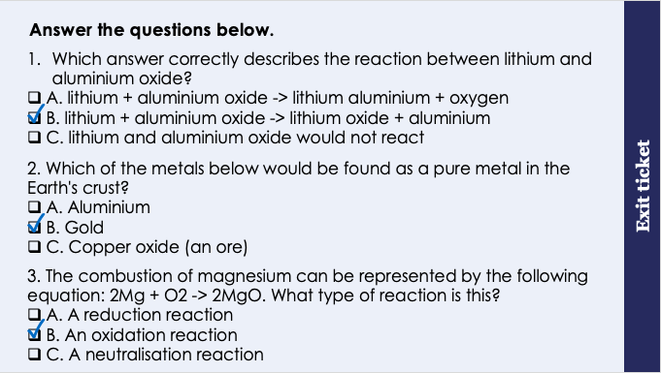
This is the fix-it portion of the lesson
The fix-it is an opportunity to respond to gaps in knowledge, especially those identified by the previous lesson’s exit ticket.
The teacher should customise this slide as needed, to facilitate
reteach, explanation, demonstration or modelling of ideas and concepts that students have not yet grasped or have misunderstood.
practise answering specific questions or of key skills.
redrafting or improving previous work.
Notes:
Fix-it guidance from previous exit ticket:
Q1. Answer: B
If students answer A, they recognise that displacement is occurring, however they have displaced the oxygen instead of the metal. To fix-it, remind students that in displacement reactions the metal replaced another metal. Give students some example displacement reaction equations to complete.
If students answer C, they either think that lithium is less reactive than aluminium, or the think that a more reactive metal cannot displace a less reactive metal. To fix-it, remind students to refer to their reactivity series handout. Remind students that more reactive metals displace less reactive metals. Give students some more practise displacement reaction equations to complete.
Q2. Answer: B
If students answer A, they have not grasped that only the very least reactive metals are found as pure metals in the Earth’s crust. To fix-it, use the reactivity series to show students which metals are found as pure metals in the Earth’s crust.
If students answer C, they have confused the term ‘ore’ with ‘metal’. Although ores are also found in the Earth’s crust, they are not pure metals (they contain enough metal to be extracted economically). To fix-it, remind students of the definition of an ore, with some examples. Show the formula of a common ore and ask students to explain why this is different to a pure metal. A particle diagram may be helpful to illustrate this point.
Q3. Answer: B
If students answer A, they may have mixed up oxidation reaction with reduction reaction. To fix-it, remind students that in oxidation reactions, oxygen is added to something (hence the name), and therefore reduction is the opposite. Show some equations of oxidation and reduction reactions so that students can see this difference clearly – pointing out where oxygen is added or removed.
If students answer C, they may have guessed an answer. They do not recognise that oxygen has been added (and therefore have not grasped the idea of an oxidation reaction), and also are unable to recognise a neutralisation reaction as occurring between acids and alkalis and producing salt and water. To fix-it, remind students that in oxidation reactions, oxygen is added to something (hence the name), and therefore reduction is the opposite. Show some equations of oxidation and reduction reactions so that students can see this difference clearly – pointing out where oxygen is added or removed. Show students some examples of neutralisation reactions, pointing out the acid and alkali and common products. Ask students to identify the type of reaction from a list of equations.

Slide 8
Atoms and Ions
An ion is a charged particle, or group of particles
Atoms form ions in order to achieve a stable electronic arrangement
2-
An atom becomes a negative ion when it gains electrons.
Non-metals usually form negative ions
×
×
An atom becomes a positive ion when it loses electrons.
Metals usually form positive ions
O
O²⁻
×
+
×
×
×
×
×
×
×
×
What will be the charge on..
a potassium ion?
a fluoride ion?
a calcium ion?
×
×
×
×
+ (K⁺)
×
×
×
×
×
×
- (F⁻)
×
×
2+ (Ca²⁺)
Na
Na⁺
Notes:
Model teacher exposition
Let’s revisit the term ‘ion’ which we’ve talked about already in this unit.
An ion is a charged particle, or group of particles. You could ask students to repeat this in a choral response.
Why do atoms form ions? Atoms form ions in order to achieve a stable electronic arrangement.
A stable electronic arrangement means a full outer shell. When atoms have a full outer shell they are stable – or less reactive.
Thinking back to year 9 chemistry, which group of the Periodic Table already has a stable electronic arrangement (full outer shell of electrons), and therefore is unreactive? The Noble Gases.
Can anyone remember the word we used to describe them, that means they are unreactive? Inert
Let’s start by thinking about non-metal atoms. Here we can see a non-metal atom drawn. It has the electronic configuration 2, 6.
What type of atom is this? Oxygen, because it has 8 electrons, and the atomic number for oxygen is 8.
What group of the Periodic Table is oxygen found in? Group 6, because it has 6 electrons in it’s outer shell.
Check both of these assumptions with students by all looking up oxygen on their Periodic Tables.
Does oxygen have a stable electronic arrangement? No
How do you know? Because it does not have a full outer (valence) shell of electrons.
What would need to happen for oxygen to have a stable electronic arrangement? It would need to get two more electrons, so that it had 8 on the outer (valence) shell.
Exactly! When oxygen reacts, it will often gain 2 electrons to form an oxide ion.
Now, we know electrons have what kind of a charge? negative charge
So, if an atom is receiving 2 negative charges, and it’s starting off as neutral, then the overall charge when it becomes an ion will be 2-.
We write this outside the square bracket on the top right. The number goes before the charge. If the charge is + or – 1 then we can just write the charge and not a number.
Repeat this narrative for metals.
Notice that the charge on the metal ion matches the group number of the metal atom. In this example the metal is from group 1 (sodium) and the ion has a charge of 1+. This is always the case for metals!
Let’s see if we can use this to predict what charges will be on the ions of various elements.

Slide 9
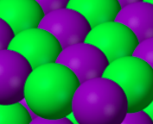
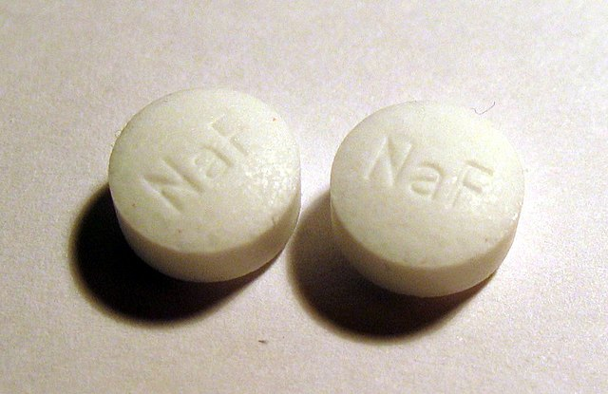
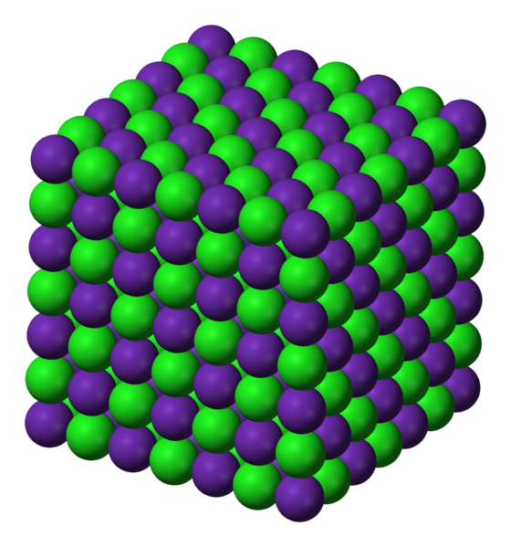
Ionic Bonding
Ionic bonding occurs in compounds formed from metals combined with non-metals.
×
+
-
×
×
×
×
×
×
×
×
×
×
×
×
×
×
×
×
×
×
×
×
×
Na⁺
F⁻
Metal: Na
2,8,1
Non-metal: F
2,7
-
NaF
-
+
-
+
Needs to lose 1 electron for a stable electronic arrangement
Needs to gain 1 electron for a stable electronic arrangement
+
-
+
The sodium atom transfers an electron to the fluorine atom
This forms a sodium ion and a fluoride ion
These oppositely charged ions have a strong electrostatic force of attraction called ionic bonding
Notes:
Model teacher exposition
Last lesson, we looked at ionic compounds.
When we looked at their structure, you might remember that ionic compounds are made of positive and negative ions. These ions have a strong electrostatic force pulling them together, and we call this an ionic bond.
But how are ionic compounds formed? Today we’re looking at the process of ionic bonding.
First of all, you need to know when ionic bonding happens. It only happens when a metal reacts with a non metal. You could briefly give an example of this by demonstrating the burning of magnesium in air. Here you can see a metal, magnesium, is reacting with a non-metal, oxygen. The product formed is magnesium oxide, an ionic compound.
We’re going to look at a number of similar reactions between metals and non-metals where ionic substances are formed.
Lets take the metal sodium, and the non-metal fluorine.
Their electronic configurations look like this.
Sodium has one electron on its outer (valence) shell, so what needs to happen for it to achieve a stable electronic arrangement? It needs to lose one electron.
Fluorine has 7 electrons on its outer (valence) shell, so what needs to happen for it to achieve a stable electronic arrangement? It needs to gain one electron.
Can anyone guess what might happen here? One needs an electron, and one needs to lose an electron.
The metal atom (sodium) transfers, or gives, one electron to the non-metal atom (fluorine). Now both of them are stable, with a full valence shell of electrons.
However! Now that electrons have been lost and gained from these atoms, they are no longer called atoms, they are ions.
Let’s redraw the atoms but now with a new number of electrons. Dual code this on the whiteboard.
We use a square bracket to show that these are ions with a charge. Dual code this on the whiteboard.
An atom that has lost electrons becomes positively charged, so a sodium atom becomes a positively charged sodium ion. It has lost one electron so the charge will be +.
An atom that has gained electrons becomes negatively charged, so the fluorine atom becomes a negatively charged fluoride ion. It has gained one electron so the charge will be -
Thinking back to last lesson, we know that these oppositely charged ions will be attracted to each other.
What is the name of this force of attraction? An electrostatic force of attraction, also known as an ionic bond.
This new compound that has been formed in this reaction is called sodium fluoride. It is an ionic compound. Because we needed one sodium atom to react with one fluorine atom, the formula of sodium fluoride is NaF. You might hear this called the empirical formula.
Sodium fluoride is a compound which is put into tablets to protect your cavities (pictured here).
Because we know that sodium fluoride is an ionic compound, you should be able to tell me about some of its properties already – think back to last lesson! It will be hard, with high melting and boiling points, form a crystalline structure, and conduct electricity when molten or dissolved in a solution.
Image: Public domain via Wikimedia Commons

Slide 10
A model of Ionic Bonding
Describe the bonding in sodium fluoride.
×
+
-
×
×
×
×
×
×
×
×
×
×
×
×
×
×
×
×
×
×
×
×
×
Na⁺
F⁻
Metal: Na
2,8,1
Non-metal: F
2,7
NaF
The sodium atom loses an electron and becomes a positively charged ion (Na⁺)
The fluorine atom gains an electron and becomes a negatively charged ion (F⁻)
The oppositely charged ions are held together by strong electrostatic forces of attraction
Notes:
Guidance:
This slide models how students should answer an ionic bonding question, specifying which atom loses/gains electron and how they become ions.

Slide 11
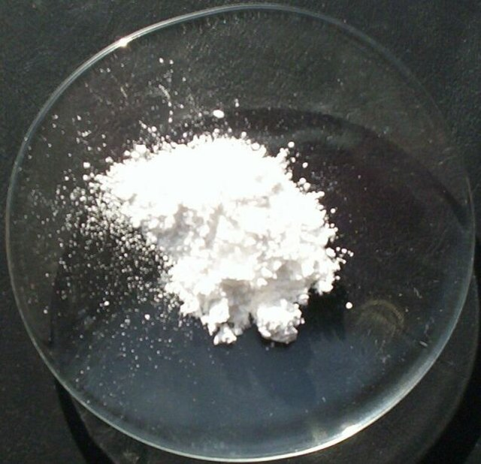
Ionic Bonding
×
2+
2-
×
×
×
×
×
×
×
×
×
×
×
×
×
×
×
×
×
×
×
×
×
×
×
Mg²⁺
O²⁻
Metal: Mg
2,8,2
Non-metal: O
2,6
The magnesium atom transfers 2 electrons to the oxygen atom
MgO
Needs to lose 2 electrons for a stable electronic arrangement
Needs to gain 2 electrons for a stable electronic arrangement
2-
This forms a magnesium ion and an oxide ion
2+
2+
2-
2-
2+
These oppositely charged ions have a strong electrostatic force of attraction called ionic bonding
2+
2-
Notes:
Model teacher exposition:
Lets take another example using the metal magnesium, and the non-metal oxygen.
Their electronic configurations look like this.
Magnesium has 2 electrons on its outer (valence) shell, so what needs to happen for it to achieve a stable electronic arrangement? It needs to lose 2 electrons.
Oxygen has 6 electrons on its outer (valence) shell, so what needs to happen for it to achieve a stable electronic arrangement? It needs to gain 2 electrons.
Can anyone guess what might happen here? One needs 2 electrons, and one needs to lose 2 electrons.
The metal atom (magnesium) transfers, or gives, 2 electrons to the non-metal atom (oxygen). Now both of them are stable, with a full valence shell of electrons.
However! Now that electrons have been lost and gained from these atoms, they are no longer called atoms, they are ions.
Let’s redraw the atoms but now with a new number of electrons. Dual code this on the whiteboard.
We use a square bracket to show that these are ions with a charge. Dual code this on the whiteboard.
An atom that has lost electrons becomes positively charged, so a magnesium atom becomes a positively charged magnesium ion. It has lost 2 electrons so the charge will be 2+.
An atom that has gained electrons becomes negatively charged, so the oxygen atom becomes a negatively charged oxide ion. It has gained 2 electrons so the charge will be 2-
Thinking back to last lesson, we know that these oppositely charged ions will be attracted to each other.
What is the name of this force of attraction? An electrostatic force of attraction, also known as an ionic bond.
This new compound that has been formed in this reaction is called magnesium oxide. It is an ionic compound. Because we needed one magnesium atom to react with one oxygen atom, the formula of magnesium oxide is MgO. You might hear this called the empirical formula.
Because we know that magnesium oxide is an ionic compound, you should be able to tell me about some of its properties already – think back to last lesson! It will be hard, with high melting and boiling points, form a crystalline structure, and conduct electricity when molten or dissolved in a solution.
Image: Public domain via Wikimedia Commons

Slide 12
Ionic Bonding
×
+
2-
×
×
×
×
×
×
×
×
×
×
×
×
×
×
×
×
×
×
×
×
×
×
Na⁺
×
O²⁻
Metal: Na
2,8,1
Non-metal: O
2,6
+
×
×
×
×
×
×
×
×
Needs to lose 1 electron for a stable electronic arrangement
Needs to gain 2 electrons for a stable electronic arrangement
×
×
×
×
×
×
×
×
×
×
Na₂O
×
×
We need 2 sodium atoms for every 1 oxygen atom
Na⁺
Each sodium atom transfers 1 electron to the oxygen atom
This forms 2 sodium ions and one oxide ion
These oppositely charged ions have a strong electrostatic force of attraction
Notes:
Model teacher exposition:
Lets take another example using the metal sodium, and the non-metal oxygen.
Their electronic configurations look like this.
Sodium has 1 electron on its outer (valence) shell, so what needs to happen for it to achieve a stable electronic arrangement? It needs to lose 1 electron.
Oxygen has 6 electrons on its outer (valence) shell, so what needs to happen for it to achieve a stable electronic arrangement? It needs to gain 2 electrons.
Can anyone guess what might happen here? One needs 2 electrons, and one needs to lose 1 electron.
We cannot just simply transfer electrons as we have in the past 2 examples. We need another sodium atom!
The metal atoms (sodium) both transfer, or give, an electron to the non-metal atom (oxygen). Now all three of them are stable, with a full valence shell of electrons.
However! Now that electrons have been lost and gained from these atoms, they are no longer called atoms, they are ions.
Let’s redraw the atoms but now with a new number of electrons. Dual code this on the whiteboard.
We use a square bracket to show that these are ions with a charge. Dual code this on the whiteboard.
An atom that has lost electrons becomes positively charged, so each sodium atom becomes a positively charged sodium ion. They have each lost 1 electron so the charge will be + on those ions
An atom that has gained electrons becomes negatively charged, so the oxygen atom becomes a negatively charged oxide ion. It has gained 2 electrons so the charge will be 2-
Thinking back to last lesson, we know that these oppositely charged ions will be attracted to each other.
What is the name of this force of attraction? An electrostatic force of attraction, also known as an ionic bond.
This new compound that has been formed in this reaction is called sodium oxide. It is an ionic compound. Because we needed two sodium atoms to react with one oxygen atom, the formula of sodium oxide is Na₂O. You might hear this called the empirical formula.
Again, because we know that sodium oxide is an ionic compound, you should be able to tell me about some of its properties already – think back to last lesson! It will be hard, with high melting and boiling points, form a crystalline structure, and conduct electricity when molten or dissolved in a solution.

Slide 13
Ionic Bonding
×
2+
-
×
×
×
×
×
×
×
×
×
×
×
×
×
×
×
×
×
×
×
×
×
×
×
F⁻
Mg²⁺
Metal: Mg
2,8,2
Non-metal: F
2,7
-
×
Needs to lose 2 electrons for a stable electronic arrangement
Needs to gain 1 electron for a stable electronic arrangement
MgF₂
×
We need 1 magnesium atom for every 2 fluorine atoms
The magnesium atom transfers 1 electron to each fluorine atom
F⁻
This forms 1 magnesium ion and 2 fluoride ions
These oppositely charged ions have a strong electrostatic force of attraction called ionic bonding
Notes:
Model teacher exposition:
Lets take another example using the metal magnesium, and the non-metal fluorine.
Their electronic configurations look like this.
Magnesium has 2 electrons on its outer (valence) shell, so what needs to happen for it to achieve a stable electronic arrangement? It needs to lose 2 electrons.
Fluorine has 7 electrons on its outer (valence) shell, so what needs to happen for it to achieve a stable electronic arrangement? It needs to gain 1 electron.
Can anyone guess what might happen here? One needs to lose 2 electrons, and one needs to gain 1 electron.
We cannot just simply transfer electrons as we have in the forst 2 examples. We need another fluorine atom!
The metal atom (magnesium) transfers, or gives, an electron to each of the non-metal atoms (fluorine). Now all three of them are stable, with a full valence shell of electrons.
However! Now that electrons have been lost and gained from these atoms, they are no longer called atoms, they are ions.
Let’s redraw the atoms but now with a new number of electrons. Dual code this on the whiteboard.
We use a square bracket to show that these are ions with a charge. Dual code this on the whiteboard.
An atom that has lost electrons becomes positively charged, so the magnesium atom becomes a positively charged magnesium ion. It has lost 2 electrons so the charge will be 2+.
An atom that has gained electrons becomes negatively charged, so the fluorine atoms become negatively charged oxide ions. They have both gained 1 electron so the charge will be – on both of those ions.
Thinking back to last lesson, we know that these oppositely charged ions will be attracted to each other.
What is the name of this force of attraction? An electrostatic force of attraction, also known as an ionic bond.
This new compound that has been formed in this reaction is called magnesium fluoride. It is an ionic compound. Because we needed 1 magnesium atom to react with 2 fluoride atoms, the formula of magnesium fluoride is MgF₂. You might hear this called the empirical formula.
Again, because we know that magnesium fluoride is an ionic compound, you should be able to tell me about some of its properties already – think back to last lesson! It will be hard, with high melting and boiling points, form a crystalline structure, and conduct electricity when molten or dissolved in a solution.

Slide 14
I: Describing the ionic bonding in lithium fluoride using dot-and-cross diagrams
Steps to Success
Draw the electronic configuration of both atoms using dots for one atom and crosses for the other.
Draw an arrow to show the transfer of any electrons from one atom to another.
Draw the ions formed after the electrons have moved with a square bracket
Write the charge of the ions formed at the top right of the square brackets
×
×
×
Metal: Li
2,1
Non-metal: F
2,7
+
-
×
×
×
Li⁺
F⁻
LiF

Slide 15
We: Describe the bonding in lithium oxide using dot-and cross-diagrams
Steps to Success
Draw the electronic configuration of both atoms using dots for one atom and crosses for the other.
Draw an arrow to show the transfer of any electrons from one atom to another.
Draw the ions formed after the electrons have moved with a square bracket
Write the charge of the ions formed at the top right of the square brackets
×
×
×
×
×
×
Metal: Li
2,1
Non-metal: O
2,6
+
+
2-
×
×
×
×
×
×
Li⁺
Li⁺
O²⁻
Li₂O

Slide 16

Is this correct?
×
×
×
×
Metal: Be
2,2
Non-metal: O
2,6
The empirical formula for beryllium oxide is Be₂O
Notes:
This statement is not correct.
Beryllium needs to lose 2 electrons to achieve a stable electron arrangement.
Oxygen needs to gain 2 electrons to achieve a stable electron arrangement.
Therefore, 1 beryllium atom will transfer electrons to 1 oxygen atom, so the formula for beryllium oxide will be BeO.
Suggested guidance:
Talk tasks can be used in a variety of ways to suit the particular needs of the students you are teaching. Through exchanging views with others, students develop their understanding of the science beyond what could be achieved individually.
Science classrooms that successfully integrate talk have the following features:
Science talk is a regular feature of lessons and is woven into classroom activities.
Students are paired or grouped strategically by the teacher to ensure productive interaction. This might take into consideration the students’ proficiency of the English language, how encouraging they might be to peers and their attainment in the topic. It’s a good idea to consider these pairings in the class seating plan.
Students are encouraged and supported to talk, but are not forced to talk.
The teacher should take on the role of a facilitator, engaging with conversations where necessary and encouraging or steering the conversation where needed.
Students are encouraged to use the language they have to express their ideas (e.g., everyday language, imperfect English, native language), but also to incorporate science specific terminology where this is more accurate or has been taught.
6. Scientifically inaccurate ideas are not dismissed by the partner or teacher; open discussion and further investigation are relied on to help students construct ideas that support them to progress in their scientific understanding.
7. Guidelines for behaviour during talk tasks are explicit and frequently reviewed. Rules for students might be:
Listen carefully to your partner
Take turns talking.
Speak one at a time, without interrupting.
Politely agree or disagree and explain why.
Politely point out if your partner has used a scientific word incorrectly, if they have explained the science incorrectly, or if there is a more accurate way to describe something.
If confused, ask questions.
Stay focused on the discussion topic.
Respond to one another.

Slide 17
You: Describe the bonding in beryllium oxide using dot-and cross-diagrams
Steps to Success
Draw the electronic configuration of both atoms using dots for one atom and crosses for the other.
Draw an arrow to show the transfer of any electrons from one atom to another.
Draw the ions formed after the electrons have moved with a square bracket
Write the charge of the ions formed at the top right of the square brackets
×
×
×
×
Metal: Be
2,2
Non-metal: O
2,6
2+
2-
×
×
×
×
Be²⁺
O²⁻
BeO

Slide 18
Think - Pair - Share
Which has a higher melting and boiling point:
Sodium fluoride or magnesium oxide?
Notes:
Magnesium oxide has a higher melting and boiling point because there is a stronger electrostatic force of attraction between the positive and negative ions. This means that it requires more energy to overcome the strong forces.
Suggested guidance:
Talk tasks can be used in a variety of ways to suit the particular needs of the students you are teaching. Through exchanging views with others, students develop their understanding of the science beyond what could be achieved individually.
Science classrooms that successfully integrate talk have the following features:
Science talk is a regular feature of lessons and is woven into classroom activities.
Students are paired or grouped strategically by the teacher to ensure productive interaction. This might take into consideration the students’ proficiency of the English language, how encouraging they might be to peers and their attainment in the topic. It’s a good idea to consider these pairings in the class seating plan.
Students are encouraged and supported to talk, but are not forced to talk.
The teacher should take on the role of a facilitator, engaging with conversations where necessary and encouraging or steering the conversation where needed.
Students are encouraged to use the language they have to express their ideas (e.g., everyday language, imperfect English, native language), but also to incorporate science specific terminology where this is more accurate or has been taught.
6. Scientifically inaccurate ideas are not dismissed by the partner or teacher; open discussion and further investigation are relied on to help students construct ideas that support them to progress in their scientific understanding.
7. Guidelines for behaviour during talk tasks are explicit and frequently reviewed. Rules for students might be:
Listen carefully to your partner
Take turns talking.
Speak one at a time, without interrupting.
Politely agree or disagree and explain why.
Politely point out if your partner has used a scientific word incorrectly, if they have explained the science incorrectly, or if there is a more accurate way to describe something.
If confused, ask questions.
Stay focused on the discussion topic.
Respond to one another.

Slide 19
Drill
What is the difference between a sodium atom and a sodium ion?
Do metal atoms lose or gain electrons?
How many valence electrons does an atom of chlorine have?
What charge ions will atoms in group 7 of the Periodic table form?
For metals, what is the relationship between the group number and the charge on the ion?
For non-metals, what is the relationship between the group number and the charge on the ion?
How many atoms of sodium would react with an atom of fluorine?
How many atoms of sodium would react with an atom of oxygen?
Why are electrons drawn with different symbols for each atom?
Explain the answer to question 7.
Notes:
Purpose: This is a knowledge drill. The purpose of this is to check that the critical knowledge is secure before pupils move onto independent practice.
Suggested guidance: There are a range of ways this could be done depending on time and ability range of the class:
Mini whiteboards
As full sentences in exercise books
As short answers in exercise books
In the pupil workbook
As pair talk
As cold call

Slide 20
Drill answers
A sodium atom is neutral (no charge) with the electronic configuration 2, 8, 1. A sodium ion is positively charged with the configuration 2, 8.
Metal atoms lose electrons.
An atom of chlorine has 7 valence electrons.
Atoms in group 7 will form ions with a charge of -1.
For metals, the group number equals the charge on the ion.
For non-metals, the group number is equal the ion × -1.
One atom of sodium would react with one atom of fluorine
Two atoms of sodium would react with one atom of oxygen.
Electrons are drawn with different symbols for each atom so the transfer of electrons from one atom to another is clear.
..because sodium transfers one electron to fluorine in order for both atoms to reach a stable electronic configuration.
Notes:
Purpose: This is a knowledge drill. The purpose of this is to check that the critical knowledge is secure before pupils move onto independent practice.
Suggested guidance: There are a range of ways this could be done depending on time and ability range of the class:
Mini whiteboards
As full sentences in exercise books
As short answers in exercise books
In the pupil workbook
As pair talk
As cold call

Slide 21
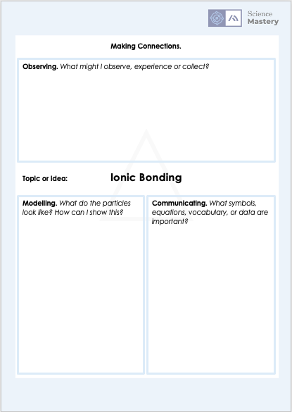
Ionic Bonding Triangle Activity
Notes:
A triangle activity requires students to make a link between
what they can observe with their senses
models provided to explain abstract ideas or concepts that cannot be directly observed
the symbols, equations, vocabulary or data that can be used to communicate this science

Slide 22
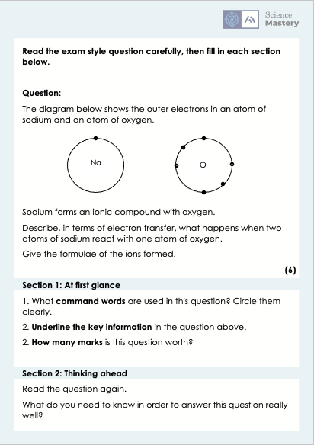
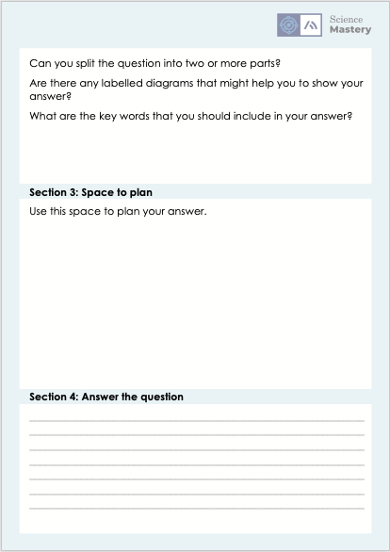
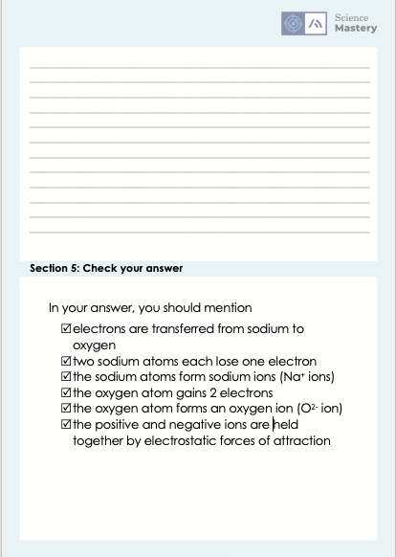
Ionic Bonding Exam Question Activity High Demand

Slide 23
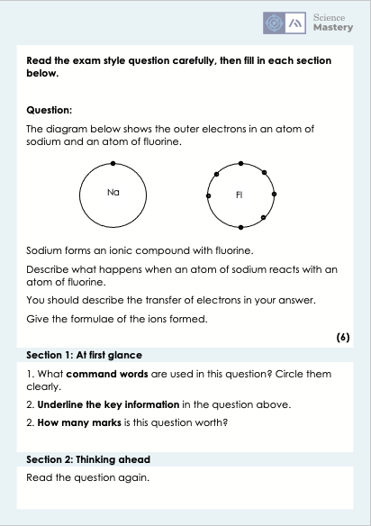
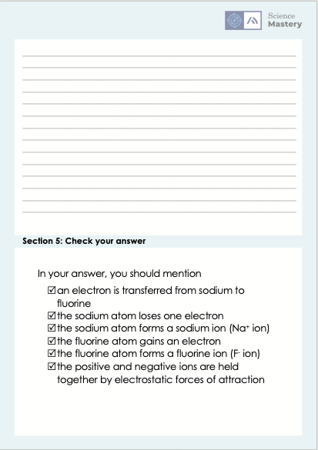
Ionic Bonding Exam Question Activity Low Demand

Slide 24
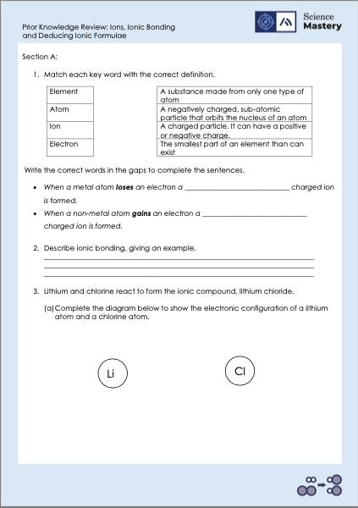
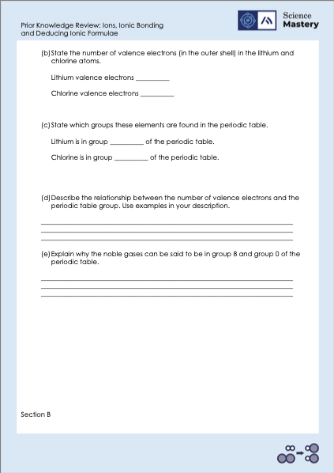
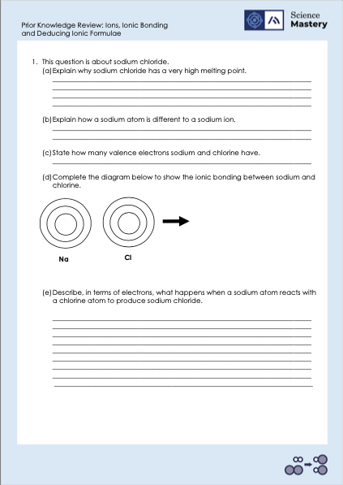
Activity

Slide 25
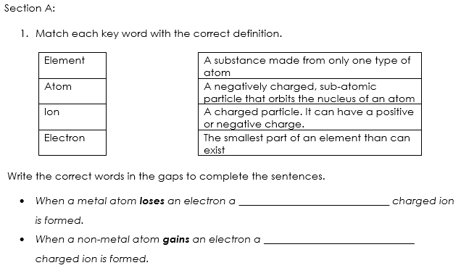
Answers – Section A
positively
negatively

Slide 26
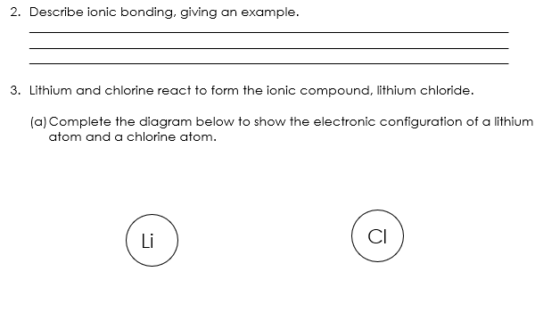
Answers – Section A
Ionic bonding occurs in compounds, for example lithium chloride, formed from metals combined with non-metals. Electrons are lost or gained to form a stable electronic configuration.
A_{r} = 3
A_{r} = 17
x
x
x
x
x
x
x
x
x
x
x
x
x
x
x
x
x
x
x
x

Slide 27
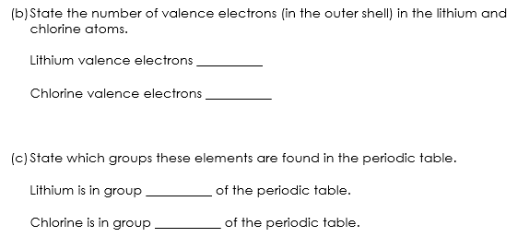
Answers – Section A
1
7
1
7

Slide 28
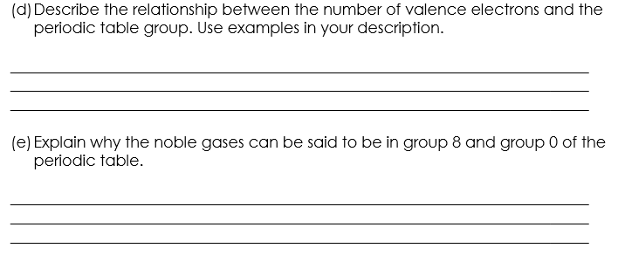
Answers – Section A
Group 1 elements, for example sodium, have one valence electron and group 7 elements, for example chlorine, have 7 valence electrons. Therefore the group number tells you the number of valence electrons/outer shell electrons.
Noble gases have a full outer shell of 8 electrons, which means that they could be said to be in Group 8. However, the noble gases are also called Group 0 because they are so stable that there are no electrons available to take part in reactions.

Slide 29
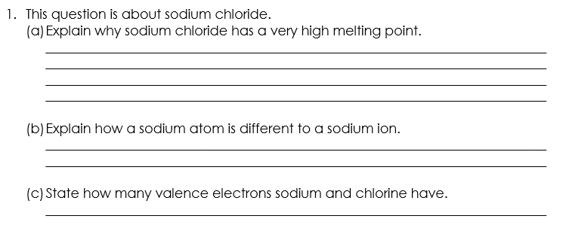
Answers – Section B
Giant ionic lattices contain strong electrostatic forces of attraction in all directions between oppositely charged ions. Therefore a large amount of energy is required to break these strong bonds to melt sodium chloride.
Sodium atoms do not have charge whereas sodium ions have a positive charge.
Sodium has one valence electron. Chlorine has 7 valence electrons.
Notes:
Additional answer:
(b) Sodium atoms are reactive whereas sodium ions have a full outer shell and, when bonded, are more stable.

Slide 30
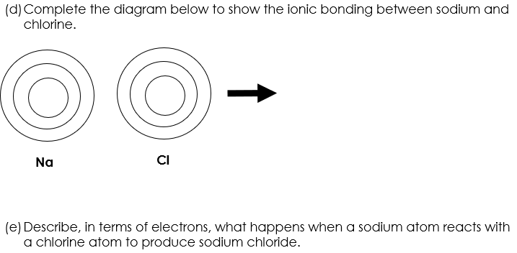
Answers – Section B
x
+
-
x
x
x
x
x
x
x
x
x
x
x
x
x
x
x
x
x
x
x
x
x
Na⁺
Cl⁻
NaCl
Sodium loses one electron and chlorine gains one electron, to form sodium chloride, NaCl. The opposite charges have electrostatic attraction and form an ionic bond. This is a more stable electron structure because both sodium and chlorine now have full outer electron shells.

Slide 31
Answer the questions below.
Which answer correctly shows a sodium ion?
A. Na
B. Na⁺
C. Na⁻
✓
2. Which statement is true?
A. Metal atoms gain electrons to become positive ions
B. Metal atoms gain electrons to become negative ions
C. Metal atoms lose electrons to become positive ions
D. Metal atoms lose electrons to become negative ions
✓
3. The ions within calcium chloride are listed below. What is the empirical formula of calcium chloride?
A. CaCl₂
B. Ca₂Cl
C. CaCl
✓
Ca²⁺
Cl⁻
Cl⁻
Notes:
Q1. Answer: B
If students answer A, they have confused atoms and ions. If students answer C, they might think that losing an electron results in a positively charged ion. To fix-it, remind students of the definition of an ion, with some examples. Show a worked example using electronic configuration diagrams that shows how an atom becomes an ion, and how we can deduce the charge on that ion. Give students some similar questions to try independently.
Q2. Answer: C
If students answer A or B, they do not realise that metal atoms would usually lose electrons. To fix-it, explain why it is that metal atoms lose electrons, and ensure that students can identify metal vs non-metal atoms. If students answer D, they are confused about how the gain or loss of electrons results in positive or negative ions. To fix-it, check that students recall that electrons have a negative charge. Help them to think about the transfer of electrons as the transfer of negative charges, so that getting negative charges results in the ion having a greater negative charge, and losing negative charges results in the ion having less of a negative charge (or more of a positive charge).
Q3. Answer: A
If students answer B, they may be associating the charge of the ions with the subscript number in the empirical formula. To fix-it, work through a similar example question with students, narrating the thinking process along the way. Explain that the number (count) of positive and negative ions is what is used to determine the empirical formula.

Slide 32
Lesson C4.2.3
What was good about this lesson? | What can we do to improve this lesson?
Send us your feedback by clicking this link
or by emailing sciencemastery@arkonline.org
Thank you!

